Slide 1
Datathon 2023
Will and Calvin

Slide 2
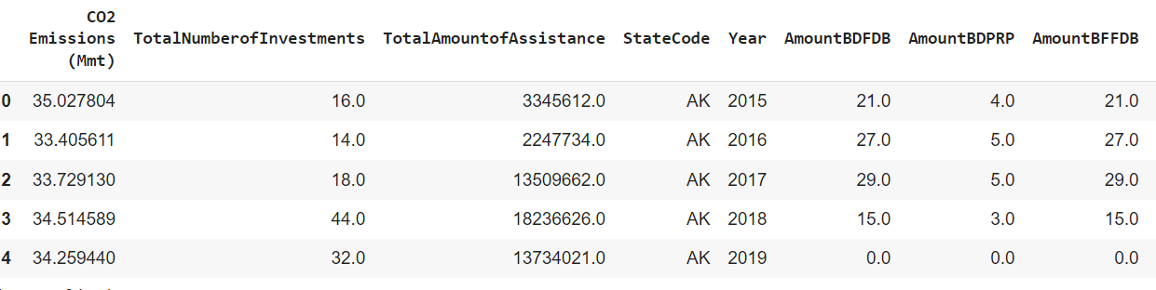
Cleaning and Preprocessing
Given long form data
Transitioned to wide form data through a series of pivots and

Slide 3
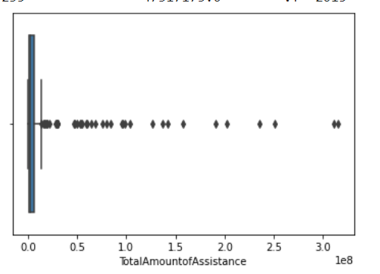
Exploration of Data
Many outliers
Wide Spread of Data
Generally Low Correlation

Slide 4
Initial Approaches
Created Baseline Model
Experiment with more models
Add more data
Weather
Political Affiliation
Number of renewable initiatives
More expenditure Data
Population Growth
Feature engineering with autoencoders
Building composite model

Slide 5
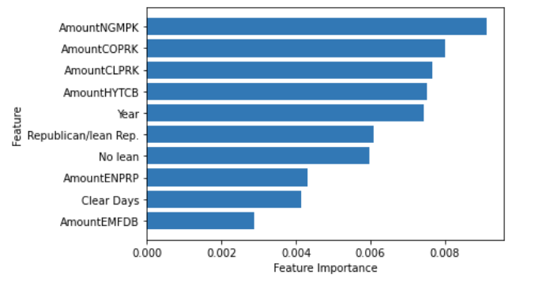
Results From Initial Approaches
Trying new models:
Baseline RMSE: around 30 million
Best RMSE: around 28 million with random forest and gradient boosting regressor
Adding more data:
Biggest increase
Best RMSE: around 26 million with random forest
Still minimal improvement
Feature Engineering
Decreased performance
Added Complexity

Slide 6
Building our Composite Model
Saw large outliers by state
Built a new model for each state
Predicted 2020 value based on 5 previous years
Saw significant improvement
Lowered RMSE to 6.9 million

Slide 7
Advantages
With more data, composite model has large advantage
More optimizable, different model for each state
Adapts to a more realistic representation of reality
Very accurate for some states, minimum error is around 6000

Slide 8
Thank you!

